Slide 1

Trade Data Analysis Project
(USING PANDAS AND MATPLOTLIB)

Slide 2
Introduction
• Dataset contains daily trade statistics
• Includes Date, Direction, Country, Commodity, Transport Mode
• Analysis includes trends, patterns, aggregations, and anomalies
• Tools: Python, Pandas, Matplotlib

Slide 3
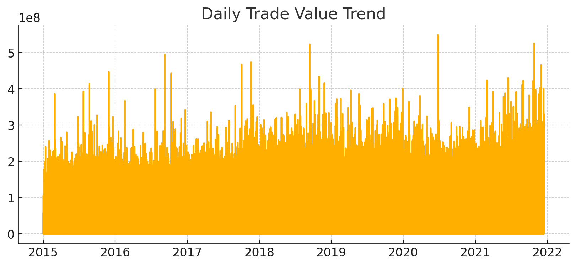
Daily Trade Value Trend

Slide 4
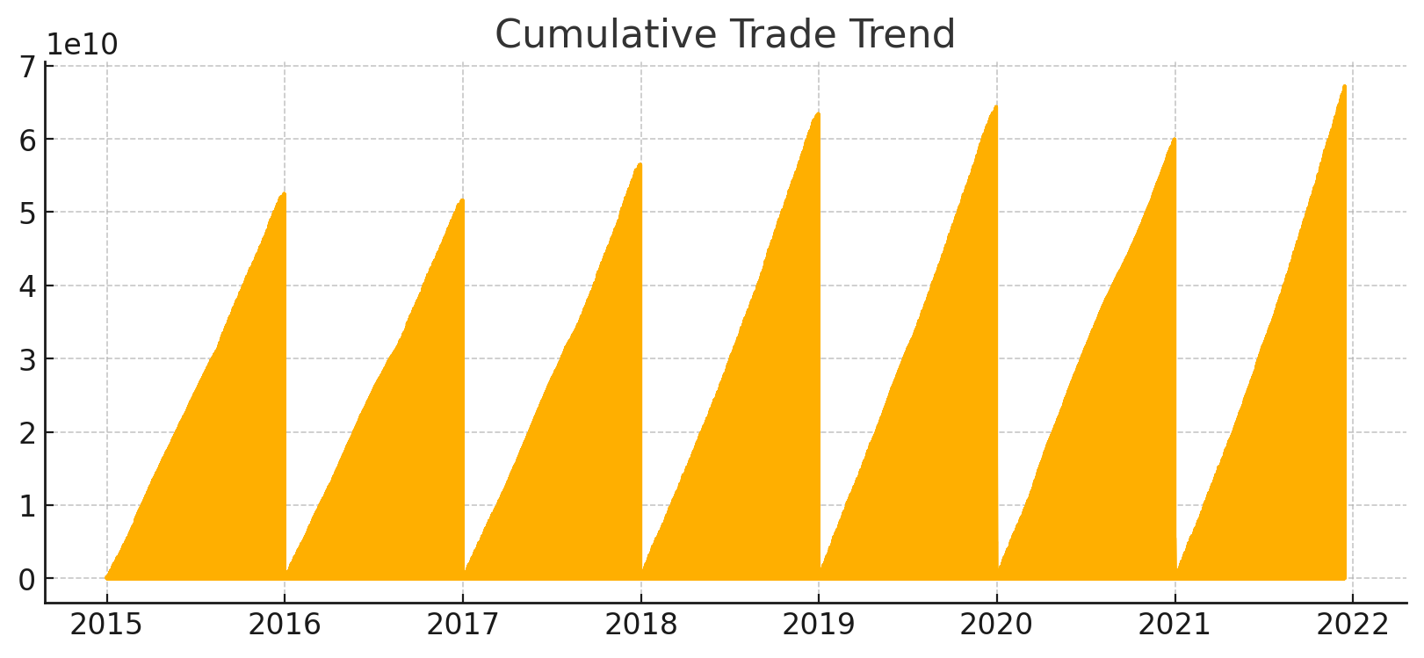
Cumulative Trend Overview

Slide 5
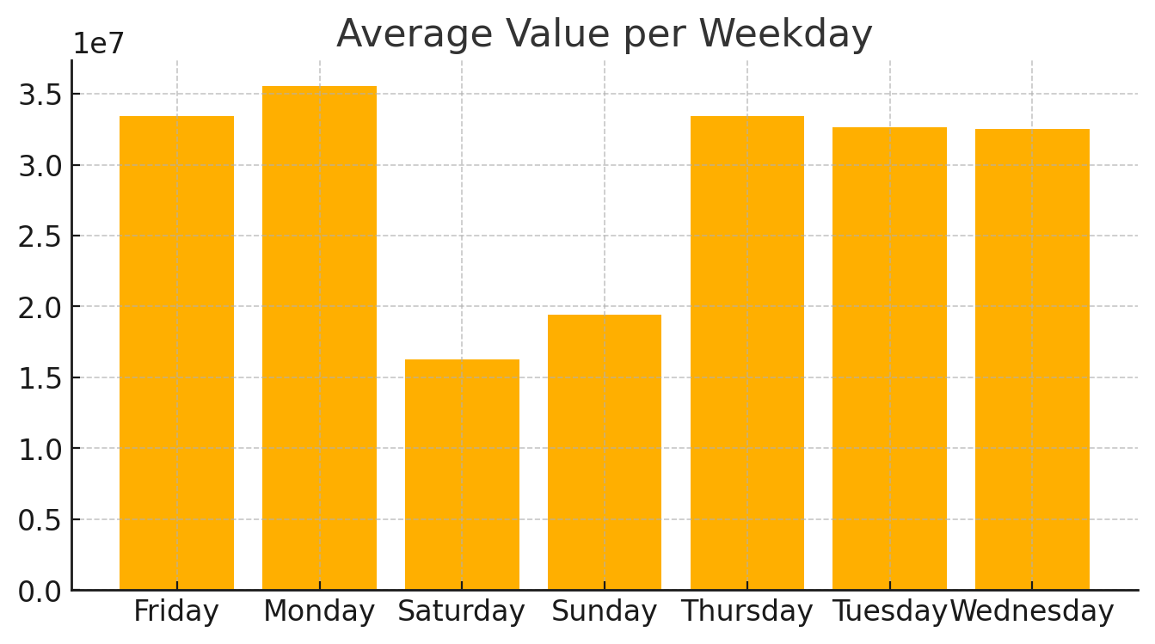
Average Value by Weekday

Slide 6
Key Insights
• Significant variance in daily trade values
• Strong cumulative upward trajectory
• Weekdays show operational performance differences
• Useful for planning, forecasting, and optimization

Slide 7
Conclusion
• Data reflects predictable temporal patterns
• Analysis supports decision‑making in trade operations
• Rolling averages and anomalies provide deeper insights
• Strong framework for future forecasting models

Slide 8
Acknowledgement / Team
Project Contributors:
• Akshat Diwakar — 202410101150080
• Vishal Maurya — 202410101150067

